Slide 1
CS6501 Embedded Operating Systems for the IoT
Introduction – August 29, 2018
Brad Campbell – bradjc@virginia.edu
http://www.cs.virginia.edu/~bjc8c/class/cs6501-f18/

Slide 2
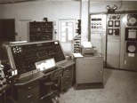
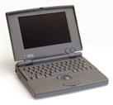
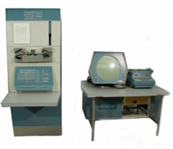
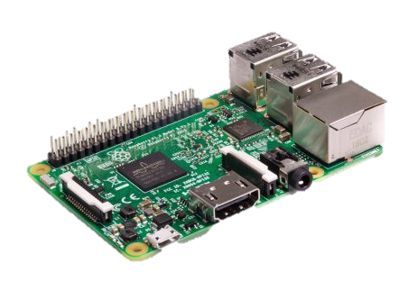
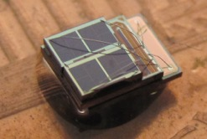

Bell’s Law of Computer Classes: A new computer class emerges roughly every decade
“Roughly every decade a new, lower priced computer class forms based on a new programming platform, network, and interface resulting in new usage and the establishment of a new industry.”
Mainframe
1 per Enterprise
Workstation
[Bell et al. Computer, 1972, ACM, 2008]
1 per Engineer
log (people per computer)
Laptop
Single-board Computers
1 per Professional
10 per person
Mini Computer
1 per Company
Personal Computer
1 per Family
1 per person
Smart Sensors
Smartphone
100 – 1000s per person

Slide 3
The Internet of Things
“Internet”: Networking, connections
“Thing”: Cyber-physical devices
“Things”: Implies some scale
Huge scope
Let’s focus on the software platforms for the things
Grounded by what operations the software must support

Slide 4
This Course
Lecture-style
What is an OS for embedded systems
Case studies of embedded OSes from the research community
Research-style
Why IoT
Key properties that require software support
Key outcomes
Understand the design and challenges for embedded operating systems
Learn to critically analyze research papers
Apply these skills to a project

Slide 5
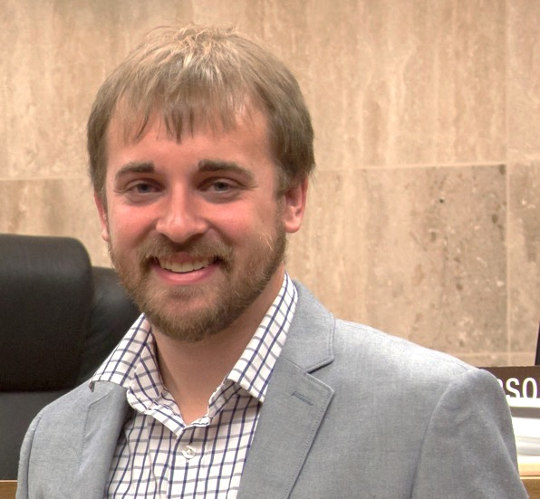
A little about me
Brad Campbell
Assistant professor
Joint appointment: 75% CS, 25% ECE
Link Lab
bradjc@virginia.edu
Ph.D. from the University of Michigan
Research interests
Energy-harvesting systems
Embedded operating systems
New sensing systems
IoT systems programming

Slide 6
Ubiquitous Computing
Are we there yet?

Slide 7
Main topics in this course
Applications
Hardware platforms
Case Studies: Embedded OSes from research
Requirements: IoT use cases

Slide 8
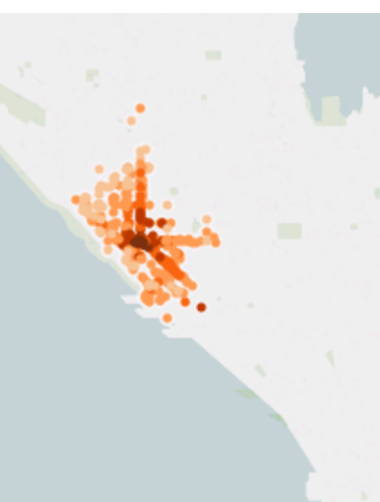
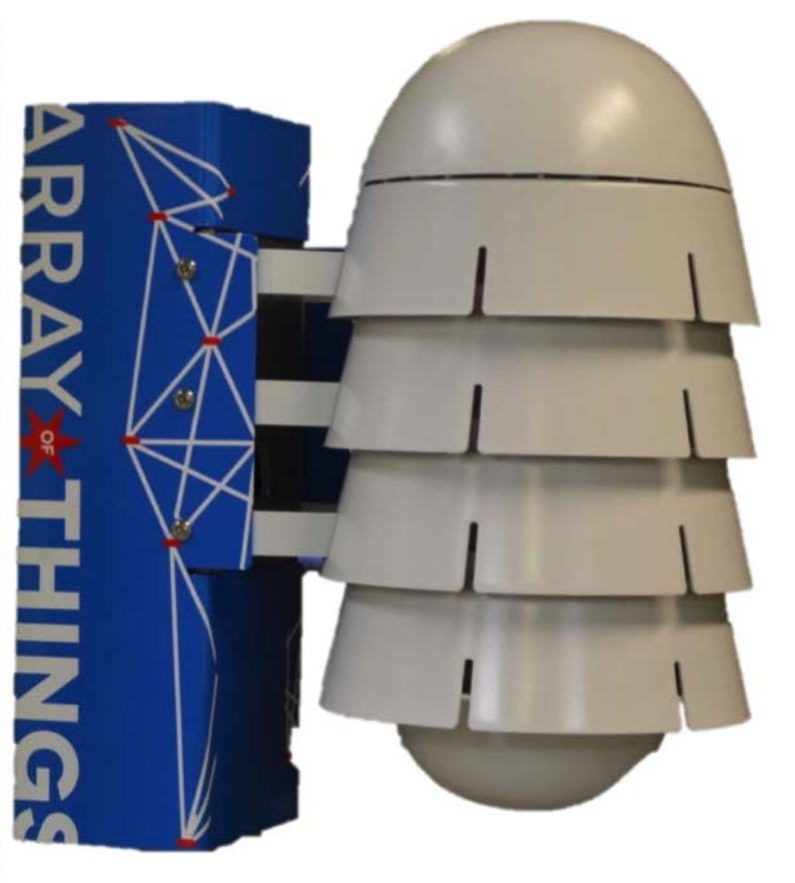
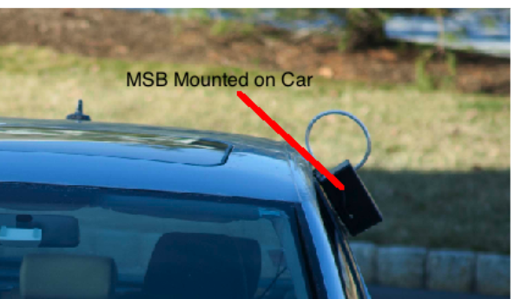
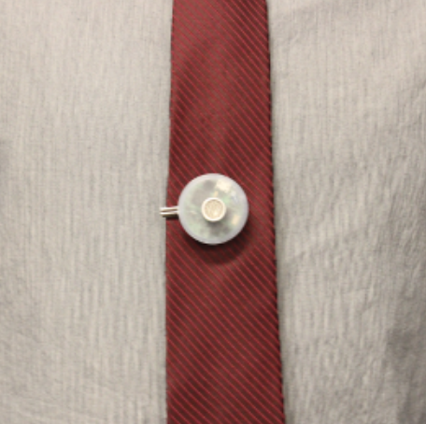
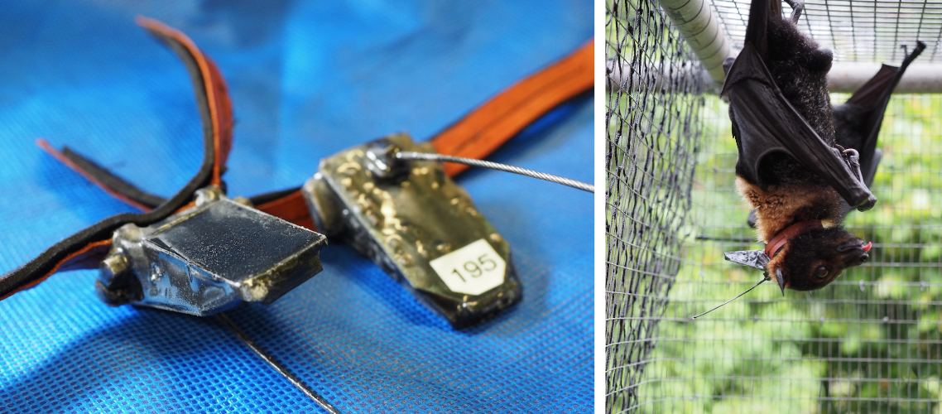
Applications
“Applications are of course the whole point” – Mark Weiser [paraphrased]
Many areas
Outdoor and environment monitoring
Buildings and energy
Safety and security
Industrial and infrastructure
Urban areas
Person health
Not just application overviews, but research systems that address specific aspects of the larger problem.

Slide 9
Application driven research
Motivated by actual problems in key domains.
Why?
Monetary: Government (and hence tax payers) invest not just for learning but also for societal benefit.
Practical: The real-world is a great testbed. Provides obvious evaluation metrics.
Impact: Real problems have more interested parties.
However, must balance with making a CS contribution.
Culture here at UVA to facilitate cross-cutting application-driven research.

Slide 10
This is a graduate class
Assumes
Familiarity with general operating system concepts
Interest in learning more about research
We will learn
About the specific constraints inherent to programming embedded systems
We will practice
Identifying the scientific method in research papers
Analyzing and critiquing existing research
Presenting and communicating clearly existing research
Applying those techniques to your own work

Slide 11
Scientific Method
Observation/topic/idea
Related work
Hypothesis
Experiments
Analysis
Conclusion
Independent and dependent variables.

Slide 12
Paper reviews
~2 reviews due before each class
Not long, but answer the following questions:
What is the problem this paper addresses, and why is it important?
What is the hypothesis of this paper?
What are two key assumptions that this paper makes?
What are the two main strengths of this paper?
What are the two main weaknesses of this paper?
Which figure or experiment was most compelling in support of the hypothesis, and why?
Sometimes the authors make these easy, other times you have to infer.
Being able to do this in your own work will make you a stronger researcher, communicator, and engineer.

Slide 13
Paper reviews cont.
Also fill in a quick survey about each paper:
Presentation (1-5):
Interest (1-5):
Impact (1-5):
Overall (1-5):
Confidence (1-5):
We’ll see how each paper ranks at the end of the semester.

Slide 14
In-class discussion lead
Each student must pick one class (or paper) to be discussion lead.
Leads must
Introduce the papers.
Discuss the paper review questions.
Facilitate a discussion about the approach, merit, and impact of the papers.
I’ll do the first couple to give one approach to being discussion lead.

Slide 15
Homeworks / Quizzes
~3 over the semester
Will cover the material from class and papers
Reinforce key concepts

Slide 16
Semester project
Use an embedded operating system
Choose application
Implement the idea
Analyze the impact of the operating system
- or -
Do a research project
Explore a new idea involving embedded operating systems
6 page paper
Implementation optional

Slide 17
Semester project presentation
Each person/group will present their project/findings at the end of the semester

Slide 18
Grading
Breakdown
15%: Discussion Lead
15%: Paper Reviews
15%: In-class Participation and Discussion
15%: Quizzes
40%: Final Project and Presentation

Slide 19
Office hours
Tuesdays 2 pm – 3 pm
Wednesdays noon – 1 pm
241 Olsson (Link Lab)

Slide 20
Check the website for reading list
http://www.cs.virginia.edu/~bjc8c/class/cs6501-f18/

